Slide 1
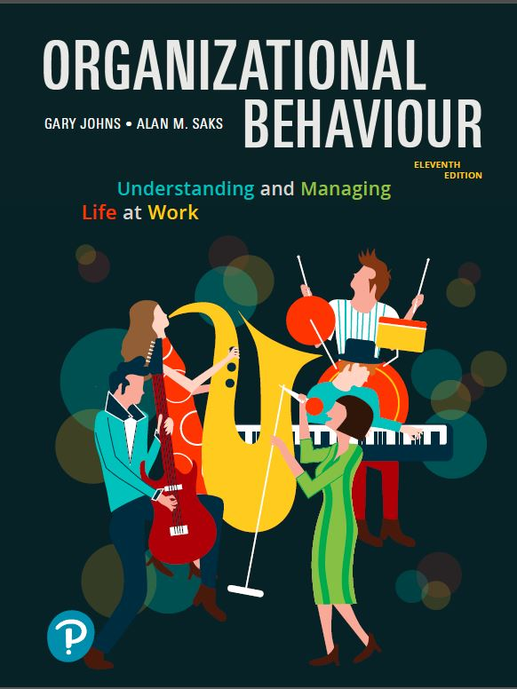
Organizational Behaviour:
Understanding and Managing Life at Work
Eleventh Edition
Chapter 4
Values, Attitudes, and Work Behaviour
Copyright © 2020 Pearson Canada Inc.

Slide 2
Learning Objectives (1 of 2)
LO4.1 Define values and discuss the implications of cross-cultural variation in values for organizational behaviour.
LO4.2 Define attitudes and explain how people develop attitudes.
LO4.3 Explain the concept of job satisfaction and discuss some of its key contributors, including discrepancy, fairness, disposition, mood, and emotion.

Slide 3
Learning Objectives (2 of 2)
LO4.4 Explain the relationship between job satisfaction and absenteeism, turnover, performance, organizational citizenship behaviour, and customer satisfaction.
LO4.5 Differentiate affective, continuance, and normative commitment and explain how organizations can foster organizational commitment.

Slide 4
What Are Values? (1 of 2)
A broad tendency to prefer certain states of affairs over others.
Values have to do with what we consider good and bad.
Values are motivational; they signal how we believe and how we should and should not behave.

Slide 5
What Are Values? (2 of 2)
Values are very general; they do not predict behaviour in specific situations very well.
People tend to hold values structured around such factors as achievement, power, autonomy, conformity, tradition, and social welfare.

Slide 6
Generational Differences in Values (1 of 4)
There are four distinctive generations in the workplace today:
  Traditionalists (1922-1945)
  Baby Boomers (1946-1964)
  Generation X (1965-1980)
  Millennials (Generation Y) (1981-2000)

Slide 7
Generational Differences in Values (2 of 4)
These generations grew up under rather different socialization experiences.
These differences have led to notable value differences between the generations.
Such value differences might underlie the differential workplace assets and preferences for leadership style.

Slide 8
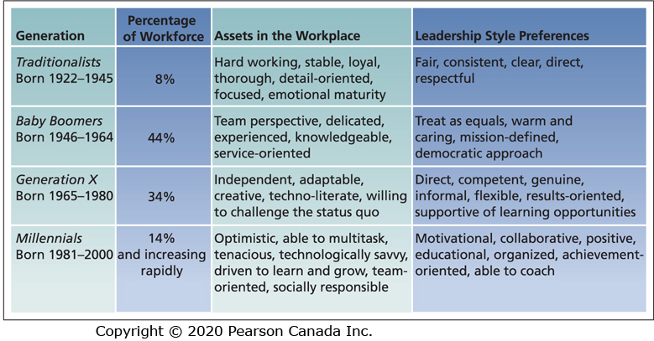
Four Generations in Today’s Workplace

Slide 9
Generational Stereotypes
Traditionalists: Respectful of authority and a high work ethic.
Boomers: Optimistic workaholics.
Gen X: Cynical, confident, and pragmatic.
Gen Y: Confident, social, demanding of feedback, and somewhat unfocused.
Are these stereotypes accurate?

Slide 10
Generational Differences in Values (3 of 4)
Most research points to more similarities than differences in values across generations, especially regarding work attitudes, motivation, and work ethic.
Some indication that Gen X and Y are more inclined to value money, status, and rapid career growth than are boomers.
Gen Ys and Xers, compared to Boomers, see work as less central, value leisure more, and are more inclined towards work-life balance.

Slide 11
Generational Differences in Values (4 of 4)
Some research has concluded that all work generations share the same values but express them differently.
Generational differences in work values or the way values are expressed is important because a good “fit” between a person’s values and those of the organization (person-organization fit) leads to more positive work attitudes and behaviours, including reduced chances of quitting.

Slide 12
Cultural Differences in Values
There are basic differences in work-related values across cultures.
There is considerable variation in how well people adjust to assignments in other cultures, with many failures.
Failed business negotiations is attributable to a lack of understanding of cross-cultural differences.
At the root of many of these problems is a lack of appreciation of basic differences in work-related values across cultures.

Slide 13
Work Centrality
Work is valued differently across cultures.
There are cross-national differences in the extent to which people perceive work as a central life interest.
People for whom work is a central life interest work more hours.
Cross-cultural differences in work centrality can lead to adjustment problems for foreign employees and managers.

Slide 14
Hofstede’s Study (1 of 2)
Geert Hofstede questioned over 116,000 IBM employees in 40 countries about their work-related values.
He discovered four basic dimensions along which work-related values differed across cultures:
  Power distance
  Uncertainty avoidance
  Masculinity/femininity
  Individualism/collectivism

Slide 15
Hofstede’s Study (2 of 2)
Subsequent work with Canadian Michael Bond that catered more to Eastern cultures resulted in a fifth dimension:
  Long-term/short-term orientation

Slide 16
Power Distance (1 of 2)
The extent to which an unequal distribution of power is accepted by society members.
In small power distance cultures, inequality is minimized, superiors are accessible, and power differences are downplayed.

Slide 17
Power Distance (2 of 2)
In large power distance cultures, inequality is accepted as natural, superiors are inaccessible, and power differences are highlighted.
Out of 76 countries and regions, Canada and the United States rank 15 and 16, falling on the low power distance side of the average.

Slide 18
Uncertainty Avoidance (1 of 2)
The extent to which people are uncomfortable with uncertain and ambiguous situations.
Strong uncertainty avoidance cultures stress rules and regulations, hard work, conformity, and security.

Slide 19
Uncertainty Avoidance (2 of 2)
Cultures with weak uncertainty avoidance are less concerned with rules, conformity, and security, and hard work is not seen as a virtue and risk taking is valued.
Canada and the United States are well below average on uncertainty avoidance.

Slide 20
Masculinity/Femininity (1 of 2)
Masculine cultures clearly differentiate gender roles, support the dominance of men, and stress economic performance.
Feminine cultures accept fluid gender roles, stress sexual equality, and stress quality of life.

Slide 21
Masculinity/Femininity (2 of 2)
In Hofstede’s research, Japan is the most masculine society followed by Austria, Mexico, and Venezuela.
The Scandinavian countries are the most feminine.
Canada ranks about mid-pack and the United States is fairly masculine falling about halfway between Canada and Japan.

Slide 22
Individualism/Collectivism (1 of 2)
Individualistic societies stress independence, individual initiative, and privacy.
Collective cultures favour interdependence and loyalty to family or clan.

Slide 23
Individualism/Collectivism (2 of 2)
The United States, Australia, Great Britain, and Canada are among the most individualistic societies.
Venezuela, Columbia, and Pakistan are among the most collective, with Japan falling about mid-pack.

Slide 24
Long-Term/Short-Term Orientation (1 of 2)
Cultures with a long-term orientation stress persistence, perseverance, thrift, and close attention to status differences.
Cultures with a short-term orientation stress personal steadiness and stability, face-saving, and social niceties.

Slide 25
Long-Term/Short-Term Orientation (2 of 2)
China, Hong Kong, Taiwan, Japan, and South Korea tend to be characterized by a long-term orientation.
Canada and the United States are more short-term oriented.
Hofstede and Bond argue that the long-term orientation, in part, explains prolific East Asian entrepreneurship.

Slide 26
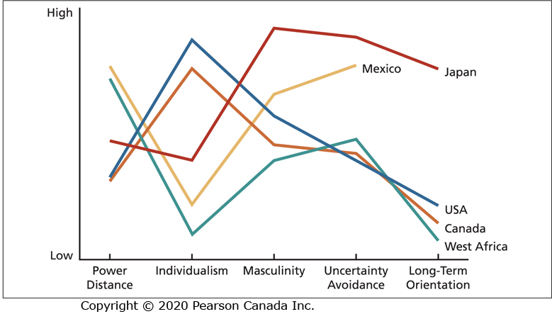
Cross-Cultural Value Comparisons

Slide 27
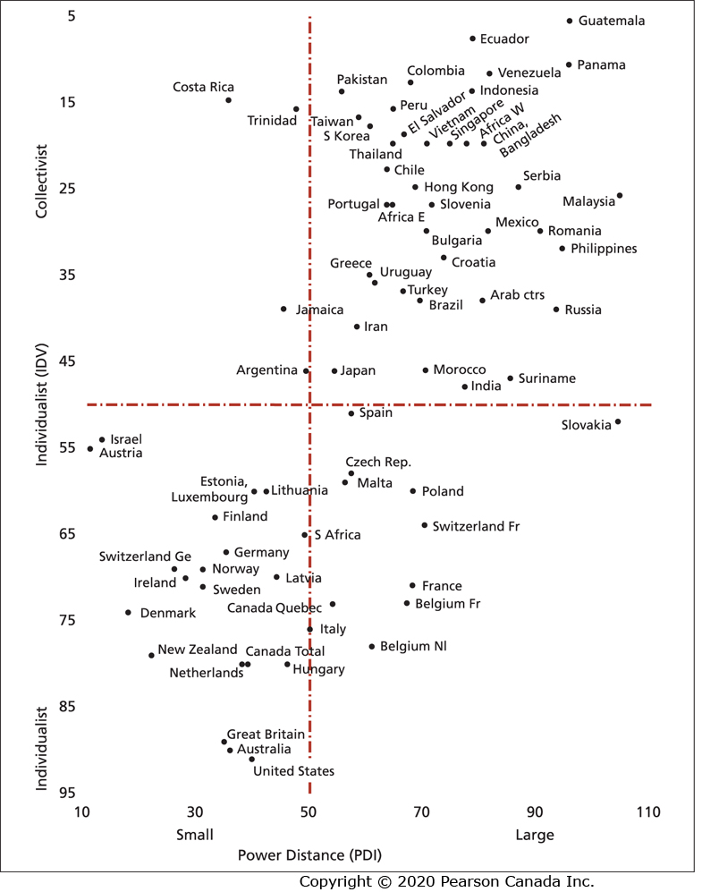
Power Distance and Individualism Values for Various Countries and Regions

Slide 28
Cultural Distance
The extent to which cultures differ in values.
Greater cultural distance impedes communication and makes negotiations, mergers, acquisitions, and joint ventures more difficult.
Expatriates working abroad will find it more difficult to adjust to more distant cultures.
However, such exposure can be beneficial.

Slide 29
Cultural Tightness versus Looseness
Tight cultures tend to have strong, clear standards for behaviour and strong sanctions for deviation from these standards.
Loose cultures are more flexible in terms of how people are expected to behave and more forgiving of violations of expected behaviour.
A wide range of behaviours might be susceptible to the tight-loose distinction, including how one dresses, how rigid social class distinctions are, and how the sexes are expected to interact.

Slide 30
Implications of Cultural Variation
What are the implications of cultural variation for organizational behaviour?

Slide 31
Exporting OB Theories (1 of 2)
Organizational behaviour theories, research, and practices from North America might not translate well to other societies.
The basic questions remain the same – it is just the answers that will differ.

Slide 32
Exporting OB Theories (2 of 2)
Managers in North America encourage participation in work decisions by employees which corresponds to a fairly low degree of power distance.
This might not transfer to cultures that value high power distance.
In extremely masculine cultures, integrating women into management positions might require special sensitivity.

Slide 33
Importing OB Theories (1 of 2)
Not all theories and practices that concern organizational behaviour are designed in North America or even in the West.
The most obvious examples are “Japanese management” techniques, such as quality circles, total quality management, and just-in-time production.

Slide 34
Importing OB Theories (2 of 2)
Difficulties can arise due to basic value differences between Japan and North America.
Many of the Japanese-inspired means of organizing work are team oriented.
Our more individualistic culture dictates that careful selection of team members is necessary.
Organizations need to tailor management practices to the home culture’s concerns.

Slide 35
Appreciating Global Customers
An appreciation of cross-cultural differences in values is essential to understanding the needs and tastes of customers or clients around the world.
Appreciating the values of global customers is also important when the customers enter your own culture.

Slide 36
Developing Global Employees
Success in translating management practices to other cultures, importing practices, and appreciating global customers does not happen by accident.
Companies need to select, train, and develop employees to have an appreciation of differences in cultural values and the implications of these differences for behaviour in organizations.
The goal is to foster cultural intelligence (CI).

Slide 37
Cultural Intelligence (CI) (1 of 2)
The capability to function and manage well in culturally diverse environments.
It encompasses knowledge, motivation, and behaviour that contribute to good cross-cultural functioning.
People with high CI tend to score high on intercultural adjustment, global leadership, and performance in intercultural settings.

Slide 38
Cultural Intelligence (CI) (2 of 2)
Canadians may be more inclined toward cultural intelligence than the Americans, British, and French.
Canadians were most inclined to enjoy interacting with those from diverse cultures and to be familiar with the values and beliefs of other cultures.

Slide 39
What Are Attitudes? (1 of 5)
An attitude is a fairly stable evaluative tendency to respond consistency to some specific object, situation, person, or category of people.
Attitudes involve evaluations directed toward specific targets.
They are more specific than values.

Slide 40
What Are Attitudes? (2 of 5)
Attitudes are tendencies to respond to the target of the attitude.
Attitudes often influence our behaviour toward some object, situation, person, or group.
Attitude → Behaviour
However, attitudes are not always consistent with behaviour.

Slide 41
What Are Attitudes? (3 of 5)
Behaviour is most likely to correspond to attitudes when people have direct experience with the target of the attitude and when the attitude is strongly and confidently held.
Where do attitudes come from?

Slide 42
What Are Attitudes? (4 of 5)
Attitudes are a function of what we think and what we feel.
Attitudes are the product of a related belief and value.
Belief + Value → Attitude → Behaviour

Slide 43
What Are Attitudes? (5 of 5)
Consider the following example of a person experiencing work-family conflict:
“My job is interfering with my family life.” (Belief)
“I dislike anything that hurts my family.” (Value)
“I dislike my job.” (Attitude)
“I’ll search for another job.” (Behaviour)

Slide 44
What Is Job Satisfaction? (1 of 3)
A collection of attitudes that workers have about their jobs.
Two aspects of satisfaction.
Facet satisfaction refers to the tendency for an employee to be more or less satisfied with various facets of the job.
The most relevant attitudes toward jobs are contained in a rather small group of facets.

Slide 45
Job Satisfaction Facets
The work itself
Compensation
Recognition
Benefits
Working conditions
Supervision
Co-workers
Organizational policy

Slide 46
What Is Job Satisfaction? (2 of 3)
Overall satisfaction is a summary indicator of a persons’ attitude toward his or her job that cuts across the various facets.
It is an average or total of the attitudes individuals hold toward various facets of the job.
Two employees might express the same level of overall satisfaction for different reasons.

Slide 47
What Is Job Satisfaction? (3 of 3)
Measures of job satisfaction include the Job Descriptive Index and the Minnesota Satisfaction Questionnaire.
They provide measures of facet satisfaction as well as an index of overall satisfaction.

Slide 48
What Determines Job Satisfaction?
We frequently find differences in job satisfaction expressed by individuals performing the same job in a given organization such as two nurses who work side by side.
How does this happen?

Slide 49
Discrepancy
According to discrepancy theory, job satisfaction is a function of the discrepancy between the job outcomes people want and the outcomes that they perceive they obtain.
There is strong evidence that satisfaction with one’s pay is high when there is a small gap between the pay received and the perception of how much pay should be received.

Slide 50
Fairness
Issues of fairness affect both what people want from their jobs and how they react to the inevitable discrepancies of organizational life.
There are three basic kinds of fairness:
  Distributive fairness
  Procedural fairness
  Interactional fairness

Slide 51
Distributive Fairness
Fairness that occurs when people receive the outcomes they think they deserve from their jobs.
It involves the ultimate distribution of work rewards and resources.
Individuals want “what’s fair.”
Equity theory provides a way of understanding how people determine what is fair.

Slide 52
Equity Theory (1 of 8)
A theory that job satisfaction stems from a comparison of the inputs one invests in a job and the outcomes one receives in comparison with the inputs and outcomes of another person or group.

Slide 53
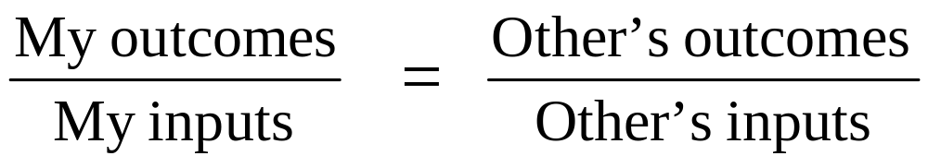
Equity Theory (2 of 8)
Equity will be perceived when the following distribution ratios exist:

Slide 54
Equity Theory (3 of 8)
Inputs refer to anything that people give up, offer, or trade to their organization in exchange for outcomes (e.g., education).
Outcomes are factors that an organization distributes to employees in exchange for their inputs (e.g., pay).
The other in the ratio might be a co-worker performing the same job, a number of co-workers, or even one’s conception of all the individuals in one’s occupation.

Slide 55
Equity Theory (4 of 8)
Equity theory has important implications for job satisfaction.
Inequity is a dissatisfying state, especially when we are on the “short end of the stick.”
Consider yourself in terms of the hours you spent studying as your input to this class and the final grade as the outcome and compare yourself to a friend in the class.

Slide 56
Equity Theory (5 of 8)
YOU | FRIEND
C grade | A grade
50 hours | 100 hours
How does this situation make you feel?

Slide 57
Equity Theory (6 of 8)
YOU | FRIEND
C grade | A grade
100 hours | 50 hours
How does this situation make you feel?

Slide 58
Equity Theory (7 of 8)
YOU | FRIEND
A grade | C grade
30 hours | 60 hours
How does this situation make you feel?

Slide 59
Equity Theory (8 of 8)
The equity concept suggests that outcomes should be tied to individual contributions or inputs.
This corresponds with the individualistic North American culture.
In more collective cultures, equality of outcomes might be more important for distributive fairness.
In more feminine cultures, allocating outcomes according to need (rather than performance) might provide for distributive fairness.

Slide 60
Procedural Fairness (1 of 3)
Fairness that occurs when the process used to determine work outcomes is seen as reasonable.
It is concerned with how outcomes are decided and allocated.
It is particularly relevant to outcomes such as performance evaluations, pay raises, promotions, layoffs, and work assignments.

Slide 61
Procedural Fairness (2 of 3)
In allocating outcomes, the following factors contribute to perceptions of procedural fairness. The allocator does the following actions:
  Follows consistent procedures over time and across people.
  Uses accurate information and appears unbiased.
  Allows two-way communication during the allocation process.
  Welcomes appeals of the procedure or allocation.

Slide 62
Procedural Fairness (3 of 3)
Procedural fairness is especially likely to provoke dissatisfaction when people also see distributive fairness as being low.
Dissatisfaction will be maximized when people believe that they would have obtained better outcomes if the decision maker had used other procedures that should have been implemented.

Slide 63
Interactional Fairness (1 of 3)
Fairness that occurs when people feel that they have received respectful and informative communication about an outcome.
Respectful communication is sincere and polite and treats the individual with dignity.
Informative communication is candid, timely, and thorough.

Slide 64
Interactional Fairness (2 of 3)
Interactional fairness is important because it is possible for absolutely fair outcomes or procedures to be perceived as unfair when they are inadequately or uncaringly explained.
People who experience interactional unfairness are most likely to be dissatisfied with the boss.
Both procedural and interactional fairness can to some extent offset the negative effects of distributive unfairness.

Slide 65
Interactional Fairness (3 of 3)
Recent findings suggest that inconsistency, being fairly treated sometimes but not others, may be more stressful than consistent unfair treatment.
The consequences of fairness and unfairness are far reaching, affecting factors such as motivation, stress, and cynicism in addition to job satisfaction.

Slide 66
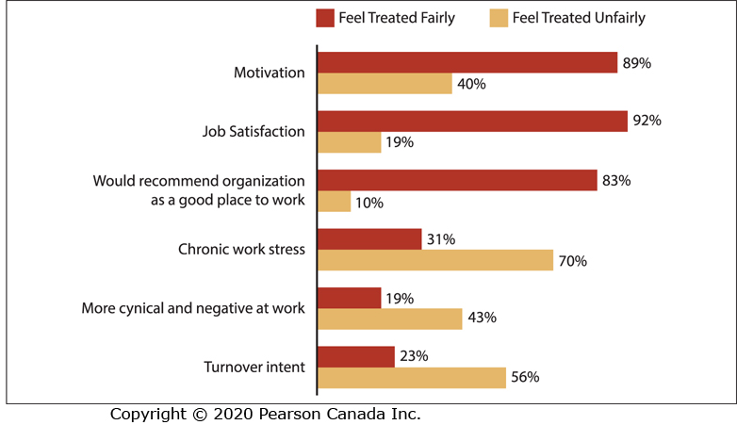
The Consequences of Fairness and Unfairness

Slide 67
Disposition (1 of 4)
Could your personality contribute to your feelings of job satisfaction?
The dispositional view of job satisfaction is based on the idea that some people are predisposed by virtue of their personalities to be more or less satisfied despite changes in discrepancy or fairness.

Slide 68
Disposition (2 of 4)
Research that disposition contributes to job satisfaction:
  Identical twins raised apart tend to have similar levels of job satisfaction.
  Job satisfaction tends to be fairly stable over time, even when changes in employer occur.
  Disposition measured early in adolescence is correlated with one’s job satisfaction as a mature adult.

Slide 69
Disposition (3 of 4)
These findings suggest that some personality characteristics originating in genetics or early learning contribute to adult job satisfaction.
People who are extraverted and conscientious tend to be more satisfied with their jobs.
Those high in neuroticism are less satisfied.
People who are high in self-esteem and internal locus of control are more satisfied.

Slide 70
Disposition (4 of 4)
In general, people who are optimistic and proactive report higher job satisfaction.
Mood and emotion may contribute to this connection.

Slide 71
Mood and Emotion
Affect is a broad label for feelings that includes emotions and moods.
Emotions (e.g., joy, anger, sadness) are intense, often short-lived feelings caused by a particular event such as a bad performance appraisal.
Moods are less intense, longer-lived, and more diffuse feelings.
How do emotions and moods affect job satisfaction?

Slide 72
Affective Events Theory
Jobs consist of a series of events and happenings that have the potential to provoke emotions or to influence moods, depending on how we appraise these events and happenings.
Emotions and moods can then influence job satisfaction.

Slide 73
Emotional Contagion
Mood and emotion can also influence job satisfaction through emotional contagion.
Emotional contagion is the tendency for moods and emotions to spread between people or throughout a group.
People’s moods and emotions tend to converge with interaction.

Slide 74
Emotional Labour (1 of 2)
Mood and emotion can also influence job satisfaction through the need for emotional labour.
Emotional labour is the requirement for people to conform to certain “display rules” in their job behaviour in spite of their true mood or emotions.

Slide 75
Emotional Labour (2 of 2)
In some jobs, employees must exaggerate positive emotions while in others they must suppress negative emotions.
All jobs have implicit display rules, however, service roles (e.g., waiter) are especially laden with them.
What are the consequences of the requirement for emotional labour?

Slide 76
Consequences of Emotional Labour
The frequent need to suppress negative emotions and fake emotions can lower job satisfaction and increase stress.
The requirement to express positive emotions boosts job satisfaction and reduces stress.
Do organizations pay a premium for emotional labour?

Slide 77
Emotional Labour and Cognitive Demands
Those in occupations with high cognitive demands tend to be paid more when the jobs are also high in emotional labour.
Occupations with low cognitive demands entail a wage penalty when emotional labour is higher.

Slide 78
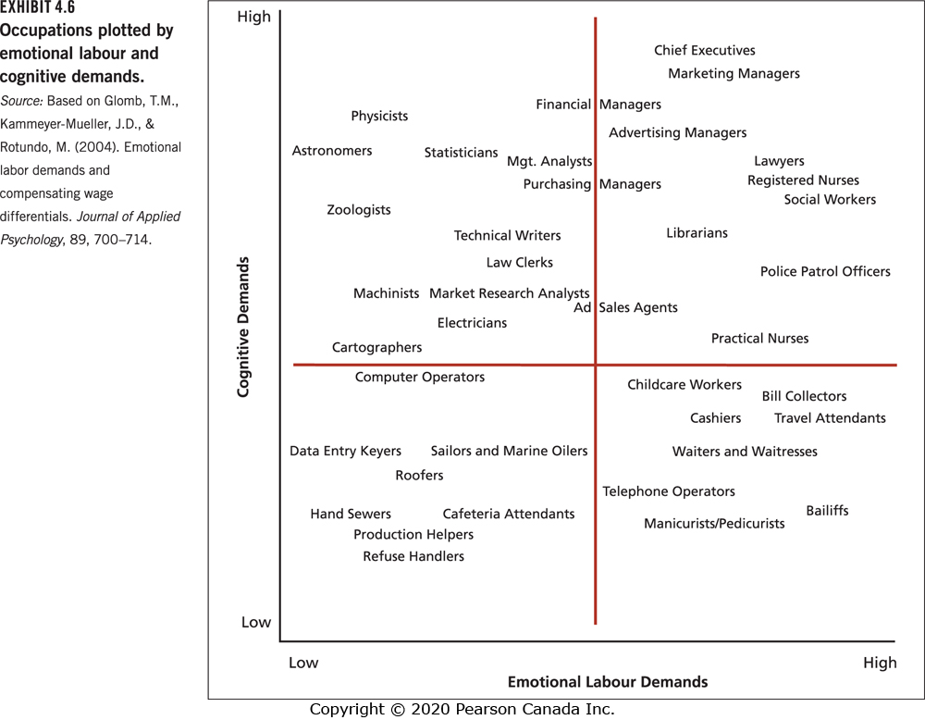
Emotional Labour Demands and Cognitive Demands

Slide 79
Determinants of Job Satisfaction: Summary
Job satisfaction is a function of:
  Dispositional factors
  Discrepancy between the job outcomes a person wants and the outcomes received
  Mood and emotion
  Fairness and equity

Slide 80
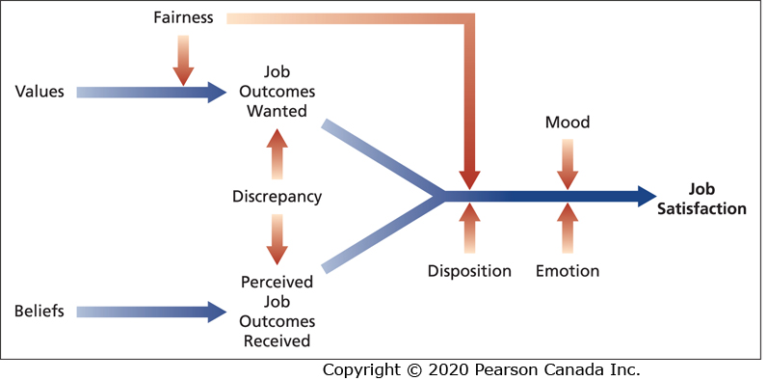
How Discrepancy, Fairness, Disposition, Mood, and Emotion Affect Job Satisfaction

Slide 81
Some Key Contributors to Job Satisfaction
The facets that seem to contribute the most to feelings of job satisfaction for most workers include:
  Mentally challenging work
  Meaningful work
  Adequate compensation
  Career opportunities
  People (friendly or helpful colleagues)

Slide 82
Mentally Challenging Work
Refers to work that tests employees’ skills and abilities, allows them to set their own working pace.
Employees perceive such work as personally involving and providing clear feedback about their performance.
Some people prefer repetitive, unchallenging work that makes few demands on them.

Slide 83
Meaningful Work
Meaningful work is work that has a positive and substantial impact on other people.
It contributes greatly to job satisfaction and also to job performance.

Slide 84
Adequate Compensation
Pay and satisfaction are positively related.
Most employees expect to receive an adequate amount of compensation.
However, not everyone is equally desirous of money and some people are willing to accept less responsibility or fewer working hours for lower pay.

Slide 85
Career Opportunities
Opportunity for promotion is an important contributor to job satisfaction because promotions contain a number of valued signals about a person’s self-worth.
Promotions contain material and social signals about a person’s self-worth.
Opportunities for growth and learning are often as important as formal promotions, especially among millennials.

Slide 86
People (1 of 2)
Friendly, considerate, good-natured superiors and co-workers contribute to job satisfaction.
The ability of others to help us do our work and attain outcomes that we value also contributes to job satisfaction.
The friendliness aspect is most important in lower-level jobs with clear duties and in dead-end jobs.

Slide 87
People (2 of 2)
The ability of others to help us do our work contributes most to job satisfaction when pay is tied to performance, jobs become more complex, and promotion opportunities increase.

Slide 88
Consequences of Job Satisfaction
Job satisfaction has a number of consequences:
  Absence from work
  Turnover
  Performance
  Organizational citizenship behaviour
  Customer satisfaction and profit

Slide 89
Absence from Work (1 of 3)
Absenteeism is an expensive behaviour.
Less satisfied employees are more likely to be absent.
Satisfaction with the content of the work is the best predictor of absenteeism.
The absence-satisfaction connection is not very strong.

Slide 90
Absence from Work (2 of 3)
Several factors constrain the ability of many people to convert their like or dislike of work into corresponding attendance patterns:
  Some absence is unavoidable.
  Some organizations have attendance control policies that influence absence more than satisfaction does.
  It might be unclear to employees how much absenteeism is reasonable or sensible.

Slide 91
Absence from Work (3 of 3)
The norm for absenteeism and the “absence culture” might have a stronger effect than individual employee’s satisfaction with their jobs.

Slide 92
Turnover (1 of 3)
Turnover refers to resignation from an organization and it can be very expensive.
High turnover rates can damage organizational financial performance.
Research indicates a moderately strong connection between job satisfaction and turnover.
Less-satisfied workers are more likely to quit.
The relationship is far from perfect.

Slide 93
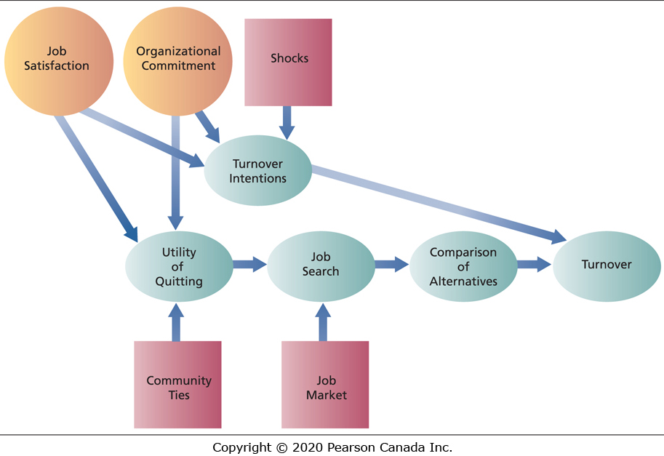
A Model of Employee Turnover

Slide 94
Turnover (2 of 3)
The model shows that job satisfaction as well as commitment to the organization and various “shocks” can contribute to intentions to leave.
Research shows that such intentions are very good predictors of turnover.
Why do satisfied people sometimes quit their jobs and dissatisfied people stay?

Slide 95
Turnover (3 of 3)
Certain “shocks” might stimulate turnover despite satisfaction with the current job.
An employees’ dissatisfaction with his or her job might be offset by a strong commitment to the overall values and mission of the organization.
An employee might be so embedded in the community that he or she is willing to endure a dissatisfying job rather than move.
A weak job market might result in limited employment alternatives.

Slide 96
The Honeymoon-Hangover Effect (1 of 3)
A decrease in job satisfaction often precedes turnover, and those who quit experience a boost in job satisfaction on their new job.
Some of this boost might be due to a “honeymoon effect,” in which the bad facets of the old job are gone, the good facets of the new job are apparent, and the bad facets of the new job are not yet known.

Slide 97
The Honeymoon-Hangover Effect (2 of 3)
Over time, as the bad facets of the new job are recognized, a “hangover effect” can occur in which overall satisfaction with the new job decreases.
Not all turnover is bad as poor performers might leave.
Turnover allows for fresh thinking as new recruits join the organization.

Slide 98
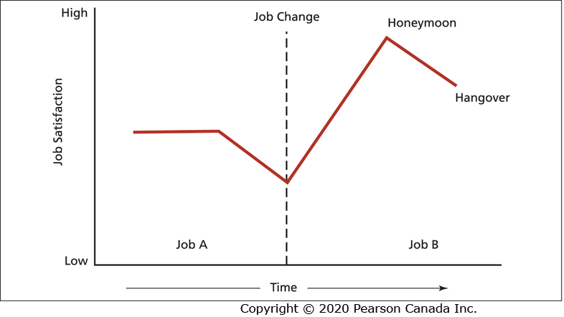
The Honeymoon-Hangover Effect (3 of 3)

Slide 99
Performance (1 of 3)
Research has found that job satisfaction is associated with higher job performance.
However, the connection is complicated; many factors influence motivation and performance besides job satisfaction.
The most important satisfaction facet for stimulating performance is the content of the work itself.

Slide 100
Performance (2 of 3)
The connection between job satisfaction and performance is stronger for complex, high-tech jobs and less strong for more routine labour jobs.
Although job satisfaction contributes to performance, performance can also contribute to job satisfaction.
When good performance is followed by rewards, employees are more likely to be satisfied.

Slide 101
Performance (3 of 3)
Many organizations do not reward good performance sufficiently.
Thus, research indicates that satisfaction is more likely to affect performance, rather than the reverse.

Slide 102
Organizational Citizenship Behaviour (OCB) (1 of 5)
OCB is voluntary, informal behaviour that contributes to organizational effectiveness.
In many cases, the formal performance evaluation system does not detect and reward it.
Job satisfaction contributes greatly to the occurrence of OCB, more than it does to regular task performance.

Slide 103
Organizational Citizenship Behaviour (OCB) (2 of 5)
The defining characteristics of OCB:
  The behaviour is voluntary.
  The behaviour is spontaneous.
  The behaviour contributes to organizational effectiveness.
  The behaviour is unlikely to be explicitly picked up and rewarded by the performance evaluation system.
What forms might OCB take?

Slide 104
Organizational Citizenship Behaviour (OCB) (3 of 5)
The various forms that OCB might take:
  Helping behaviour and offering assistance to others.
  Conscientiousness to the details of work.
  Being a good sport.
  Courtesy and cooperation.
How does job satisfaction contribute to OCB?

Slide 105
Organizational Citizenship Behaviour (OCB) (4 of 5)
Fairness seems to be key.
Although distributive fairness is important, procedural and interactional fairness from a supportive manager seem especially critical.
OCB is also influenced by employees’ mood at work.

Slide 106
Organizational Citizenship Behaviour (OCB) (5 of 5)
People in a pleasant, relaxed, optimistic mood are more likely to provide special assistance to others.
OCB contributes to organizational productivity and efficiency and to reduced turnover.
There is sometimes a progression of withdrawal in response to job dissatisfaction.

Slide 107
Progression of Withdrawal (1 of 3)
People withdraw their attention or work effort to compensate for dissatisfaction.
This begins with more subtle behaviours and progresses to more extreme behaviours until some equilibrium is struck.
A reduction in OCB is often the first withdrawal response.

Slide 108
Progression of Withdrawal (2 of 3)
This may be followed by coming to work late, then absenteeism, and ultimately turnover.
Managers should be alert to increases in the lower forms of withdrawal, because they may signal bigger problems in the future.

Slide 109
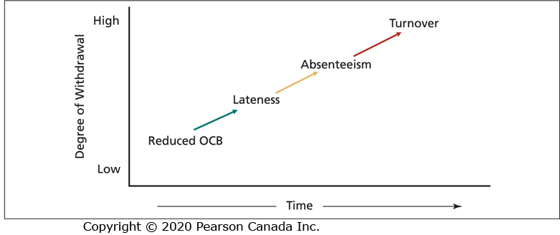
Progression of Withdrawal (3 of 3)

Slide 110
Customer Satisfaction and Profit (1 of 2)
A growing body of evidence has established that employee job satisfaction is translated into customer or client satisfaction and organizational profitability.
Organizations with higher average levels of employee satisfaction are more effective.
The same applies to units within larger organizations.
How does employee satisfaction translate into customer satisfaction?

Slide 111
Customer Satisfaction and Profit (2 of 2)
Reduced absenteeism and turnover contribute to the seamless delivery of service.
OCBs stimulate good teamwork.
A good mood among employees can be contagious for customers.

Slide 112
What Is Organizational Commitment?
(1 of 3)
Organizational commitment is an attitude that reflects the strength of the linkage between an employee and an organization.
This linkage has implications for whether someone tends to remain in an organization.

Slide 113
What Is Organizational Commitment?
(2 of 3)
There are three very different types of organizational commitment:
  Affective commitment
  Continuance commitment
  Normative commitment

Slide 114
Affective Commitment
Commitment based on a person’s identification and involvement with an organization.
People with high affective commitment stay with an organization because they want to.

Slide 115
Continuance Commitment
Commitment based on the costs that would be incurred in leaving an organization or a lack of suitable job alternatives.
People with high continuance commitment stay with an organization because they have to.

Slide 116
Normative Commitment
Commitment based on ideology or a feeling of obligation to an organization.
People with high normative commitment stay with an organization because they think that they should do so.

Slide 117
What Is Organizational Commitment?
(3 of 3)
Employees can also be committed to various constituencies within and outside the organization.
Each type of commitment could also apply to one’s work team, union, or profession.

Slide 118
Key Contributors to Organizational Commitment (1 of 3)
The best predictor of affective commitment is interesting, satisfying work.
Role clarity and having one’s expectations met after being hired also contribute to affective commitment.

Slide 119
Key Contributors to Organizational Commitment (2 of 3)
Continuance commitment occurs when people feel that leaving the organization will result in personal sacrifice or they perceive that good alternative employment is lacking.
Building up “side bets” can lock employees into organizations even though they would rather go elsewhere.
Continuance commitment increases with the time a person is employed by an organization.

Slide 120
Key Contributors to Organizational Commitment (3 of 3)
Normative commitment can be fostered by benefits that build a sense of obligation to the organization.
Strong identification with an organization’s product or service can also foster normative commitment.
Socialization practices that emphasize loyalty to the organization can stimulate normative commitment.

Slide 121
Consequences of Organizational Commitment (1 of 3)
High affective commitment or high commitment across all three forms are associated with elevated job satisfaction and lower work stress, while high continuance commitment due to lack of alternatives provokes dissatisfaction and stress.
All three forms of commitment reduce turnover intentions and actual turnover.
Affective commitment is positively related to performance.

Slide 122
Consequences of Organizational Commitment (2 of 3)
Continuance commitment is negatively related to performance.
An especially bad combination for both the employee and the organization is high continuance commitment coupled with low affective commitment.
Is there a downside to organizational commitment?

Slide 123
Consequences of Organizational Commitment (3 of 3)
Very high levels of commitment can cause conflicts between family life and work life.
High levels of commitment have often been implicated in unethical and illegal behaviour.
High levels of commitment to a particular form or style of organization can cause a lack of innovation and lead to resistance when a change in culture is necessary.

Slide 124
Changes in the Workplace and Employee Commitment
Changes in the workplace have implications for organizational commitment in three main areas:
  Changes in the nature of employees’ commitment to the organization.
  Changes in the focus of employees’ commitment.
  The multiplicity of employer-employee relationships within organizations.

Slide 125
Changes in the Nature of Employees’ Commitment to the Organization
Each type of commitment can increase or decrease.
Maintaining high levels of affective commitment will be especially challenging.
Changes that are made in the organization’s best interest but that are detrimental to employees’ well-being are most likely to damage affective commitment.

Slide 126
Changes in the Focus of Employees’ Commitment
Employees have multiple commitments directed to others within in the organization as well as entities outside the organization.
Changes in the workplace might alter the focus of employees’ commitment within and outside the organization.
Changes that threaten employees’ future in the organization might result in a shift in commitment to entities outside the organization.

Slide 127
The Multiplicity of Employer-Employee Relationships within Organizations (1 of 2)
Organizations need to be flexible enough to shrink and expand their workforce and they need a workforce that is flexible.
This creates a potential conflict and requires different relationships with employee groups.

Slide 128
The Multiplicity of Employer-Employee Relationships within Organizations (2 of 2)
Core employees who perform the key operations required for organizational success should have high affective commitment.
High affective commitment is less critical for employee groups that do not perform core tasks (e.g., temporary workers).

